Slide 1
KS3 – Life on Land
Instructions for pupils
© Board of Trustees of the Royal Botanic Gardens, Kew

Slide 2
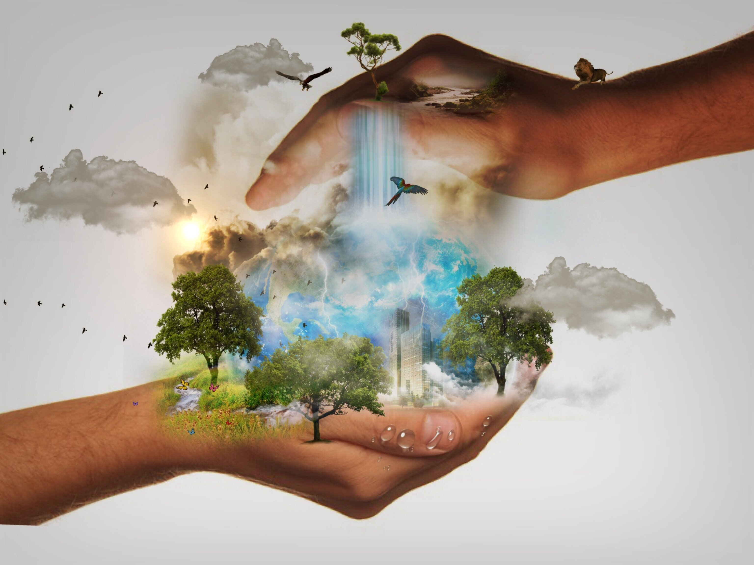
Life on land
In 2015 world leaders met to agree on goals to make the world a better place for everyone, now and in the future. They want this to happen in the next 10 years. One of these goals is called LIFE ON LAND. This goal is to protect habitats and stop plants and animals from becoming extinct.
Can you take on the challenge of answering the question: What is the most important thing we can do now to end biodiversity loss?

Slide 3
Activity 1 Watch and learn
Did you know that up to one million plant and animal species are in danger of extinction because of human activities?
Watch the video to learn more and test your knowledge.

Slide 4
Activity 2: Life on land card match
You will need a piece of paper and a pen or pencil to take part in this activity
Look at the following images and statements around protecting life on land and see if you can match them correctly
Number the paper down one side 1 – 9 for the images, then write the letter for the statement you think is a match next to it

Slide 5
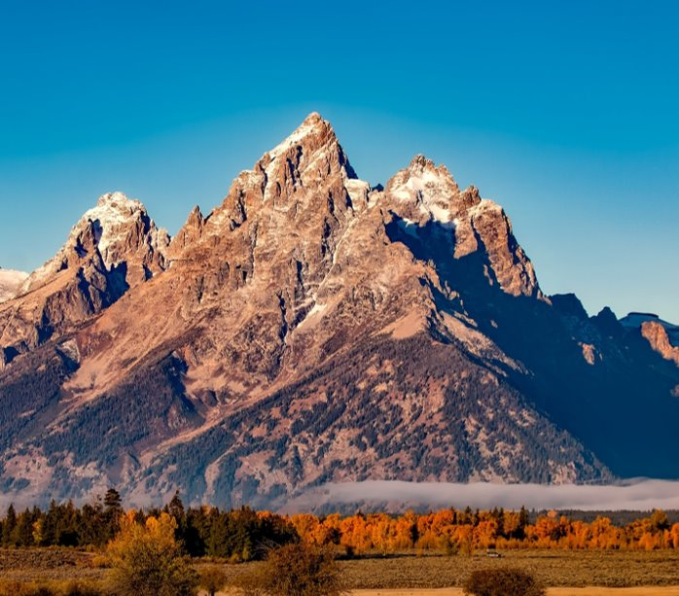
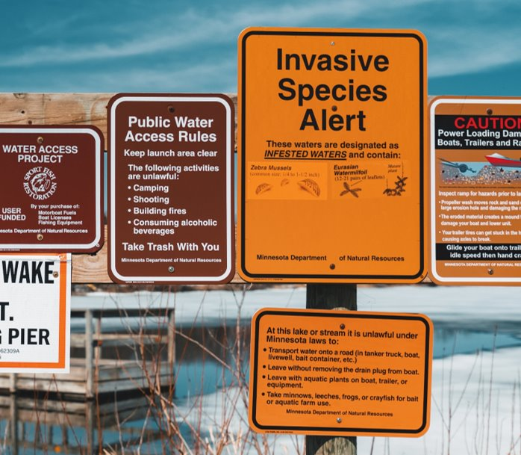
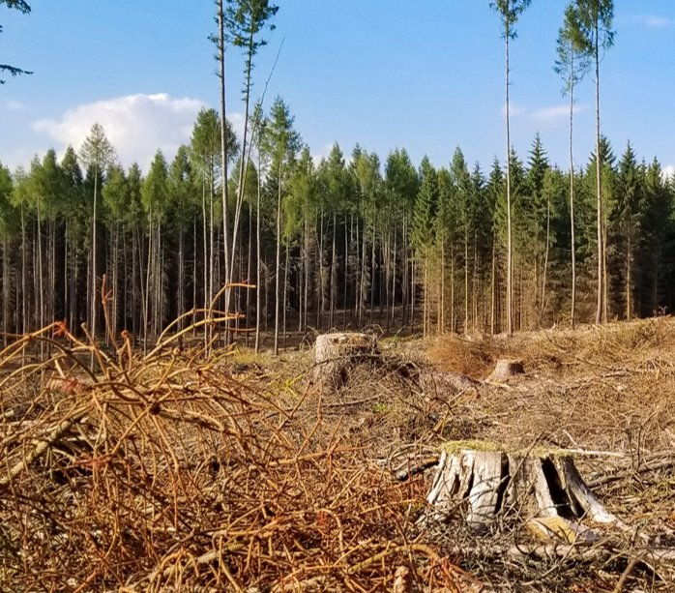
1​
2​
3​

Slide 6
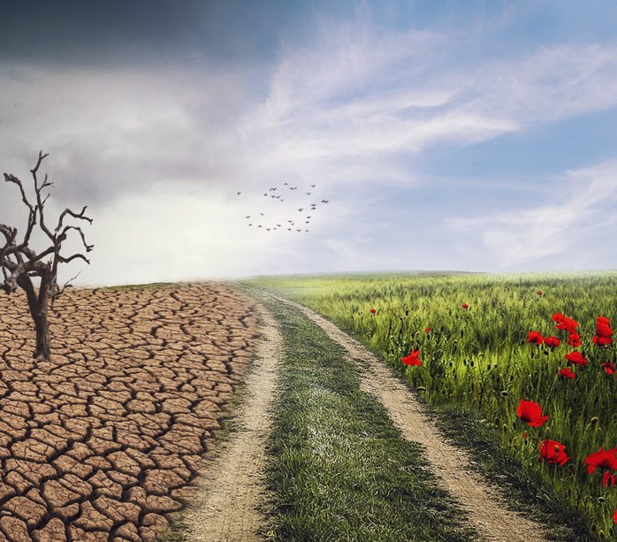
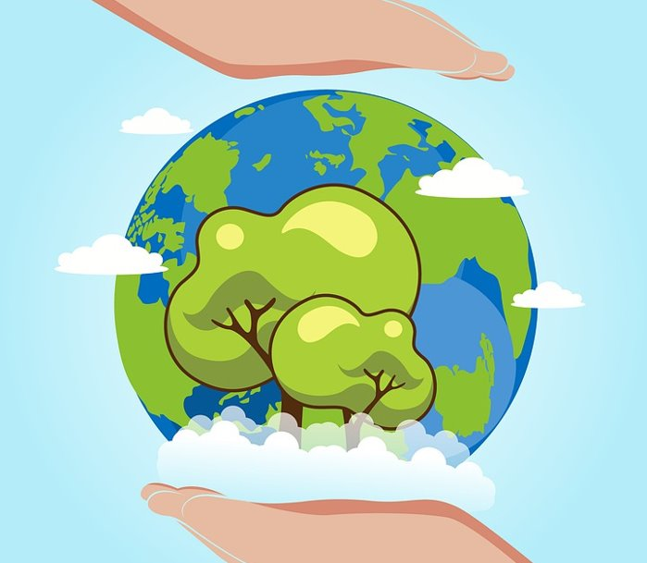
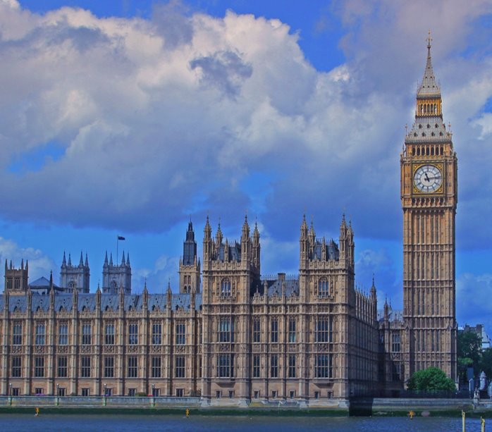
4​
5​
6​

Slide 7
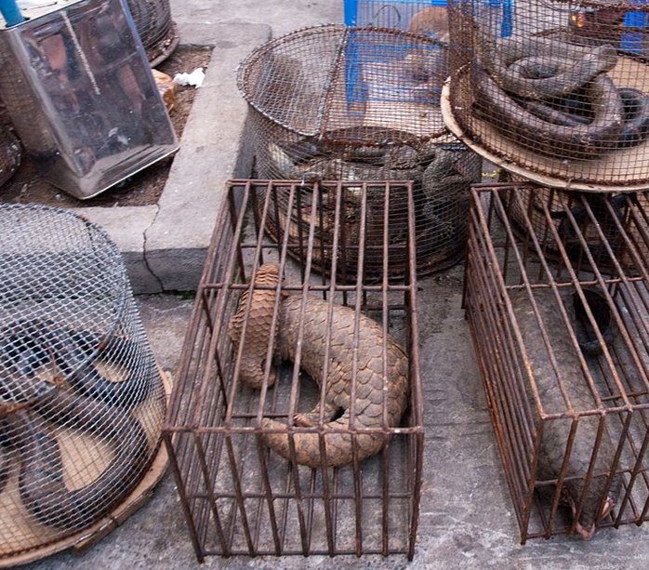
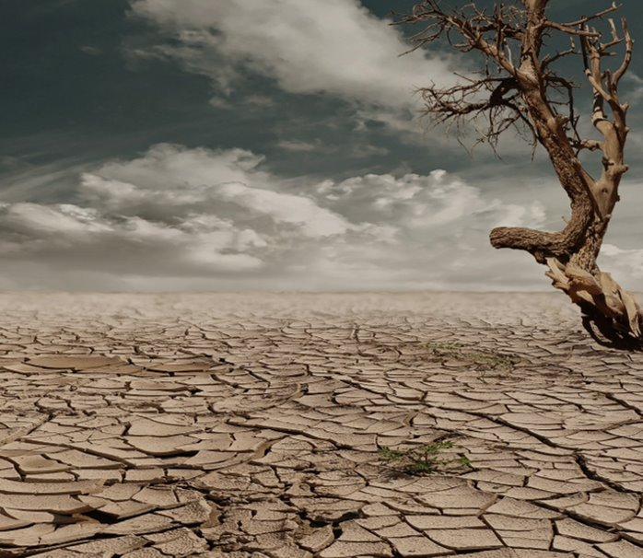
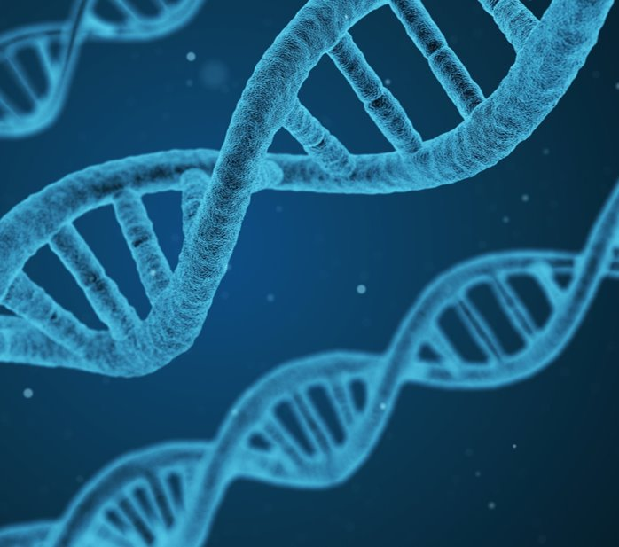
7​
8​
9​

Slide 8
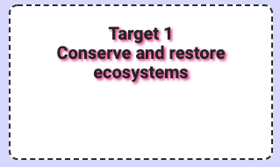
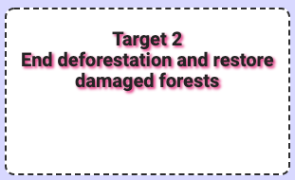
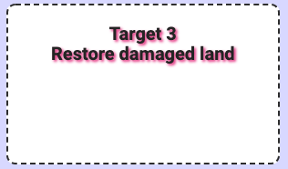
A​
B​
C​

Slide 9
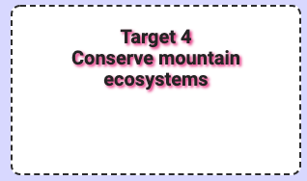
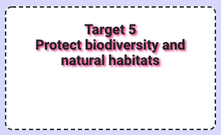
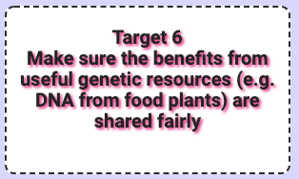
D​
E​
F​

Slide 10
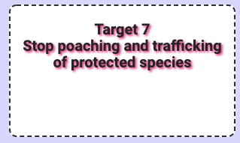
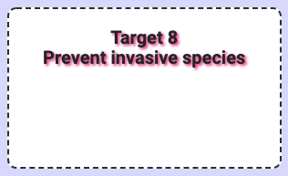
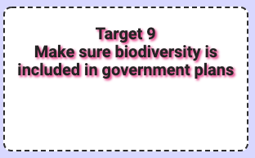
G​
H​
I​

Slide 11
The challenge
Now that you have learned lots about protecting life on land, you’re ready to take on the challenge!
Design and deliver a presentation outlining your answer to the question:
What is the most important thing we can do now to end biodiversity loss?
Make sure someone records you delivering your presentation so you can send it to your teacher!

Slide 12
Top tips
Use the internet to find out about different ways we can achieve this goal – we’ve included some useful links to help
​
Make sure your presentation covers these things:​
Content: it should show a clear understanding of the issues concerned​
Strategy: excellent structure and timing​
​​​​​​​Style: the ability to deliver your approach persuasively. Techniques include use of voice (tone), use of gestures (including body language), use of rhetorical techniques and engagement with the audience

Slide 13
Useful links
How to write and give a speech
https://www.wikihow.com/Prepare-and-Give-a-Speech
UN Sustainable Development Goals student resources
https://www.un.org/sustainabledevelopment/student-resources/
Kew biodiversity video
https://www.youtube.com/watch?v=bK9fjDMGo6c

Slide 14
All done?
Well done for completing the challenge!
We hope you enjoyed helping to raise awareness of the life on land issue.
Contact your teacher to let them know you are ready to submit your work to them.

