Slide 1
KS3 Illustrating threats to plants
Instructions for pupils
© Board of Trustees of the Royal Botanic Gardens, Kew

Slide 2
Illustrating threats to plants
The world’s plants have never been in greater peril. If current trends continue, we will lose a plant species every day for the next 50 years.
One in five of the world’s plant species are threatened with extinction. However, education is a powerful tool in raising people's awareness of the scale of the problem and showing what they can do to help. ​ ​​​​​​​Watch this video to find out your challenge, then head to the next slide to take part in an activity and test your knowledge.

Slide 3
Activity 1 Watch and learn
Did you know? Many plants could become extinct before we even know they’re at risk, or sometimes, before they’re even discovered.
Watch the video to learn more and test your knowledge.

Slide 4
Activity 2: Threats to plants
You will need a piece of paper and a pen or pencil to take part in this activity
Number the paper down one side 1 – 10
Look at each of the following images. Write down what is happening in each image, and how this could be a threat to plants.

Slide 5
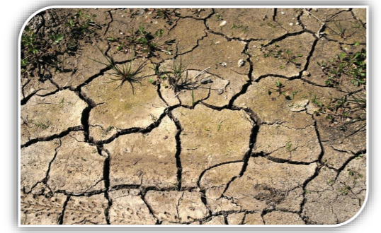
1
2

Slide 6
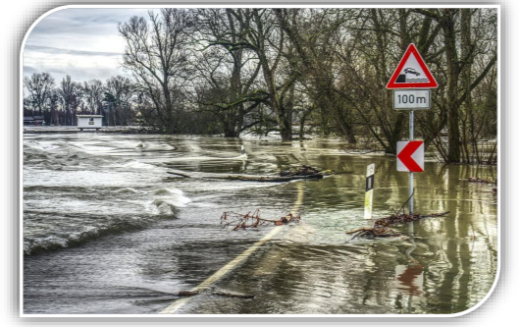
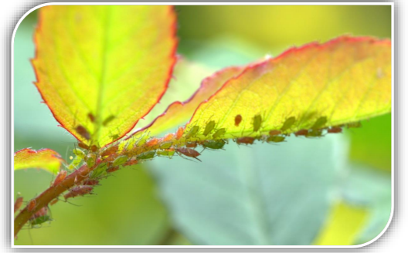
3
4

Slide 7
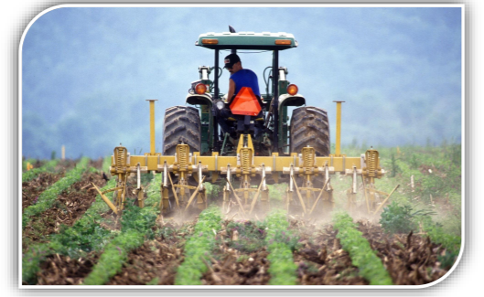
5
6

Slide 8
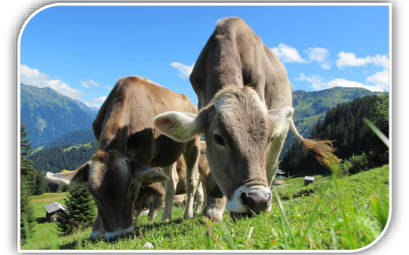
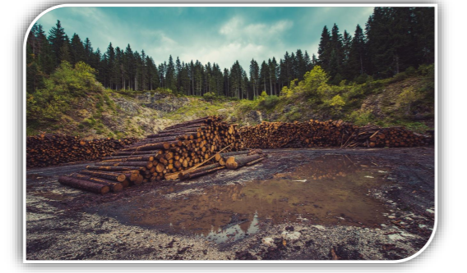
7
8

Slide 9
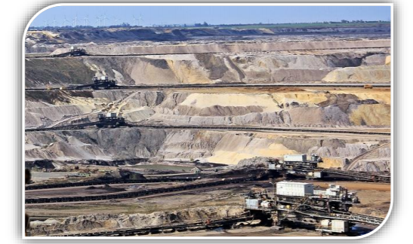
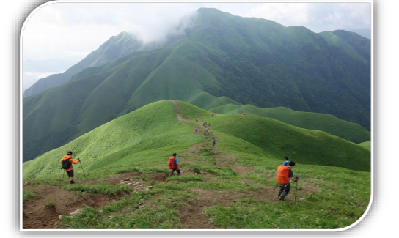
9
10

Slide 10
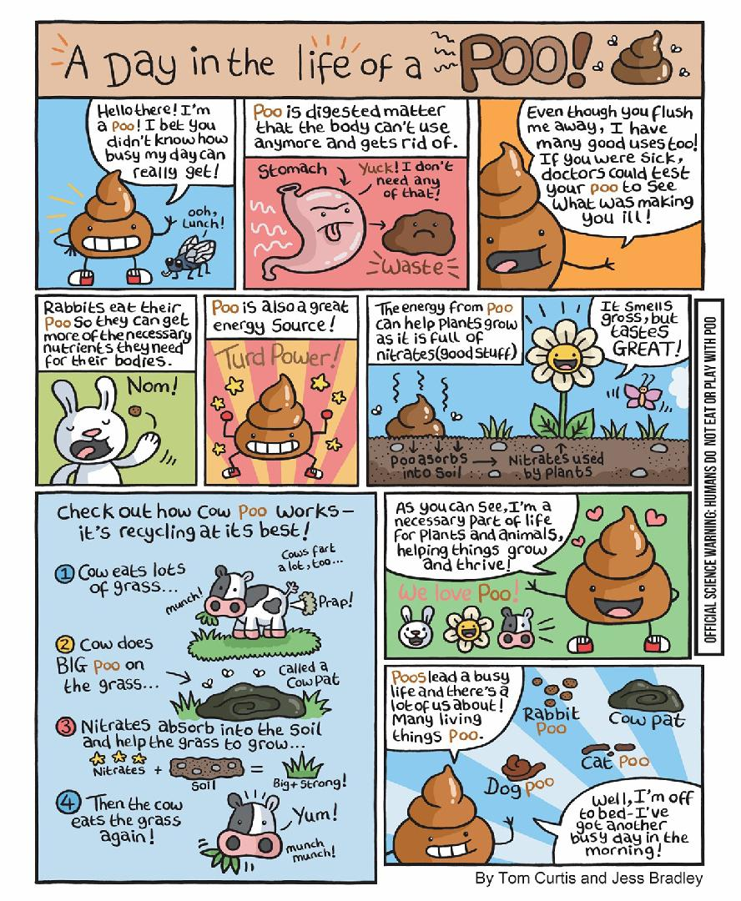
The challenge
Now that you’ve learned lots about threats to plants, you’re ready to take on the challenge!
Design a comic strip (drawn by hand or on computer) to increase awareness of different threats to temperate plants.
You can either:
Choose ONE temperate plant that is currently threatened and explain how and why that plant is threatened.
OR
Focus on the range of different ways a temperate plant could be threatened.

Slide 11
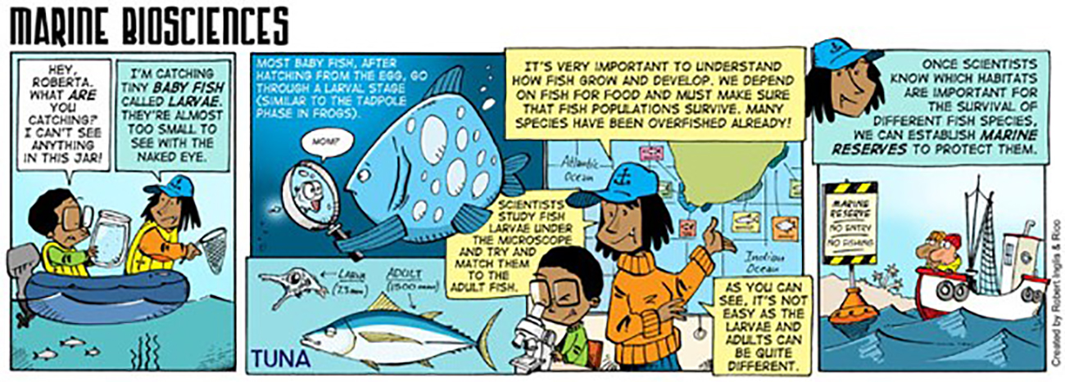
Top tips
Use books or the internet to find out about specific endangered temperate plants to feature in your comic.
Consider the tone of your comic; is it serious or light-hearted? Are you using comedy to engage people? Don’t forget that the main purpose of your comic is to educate, not simply amuse.
Use your imagination and be as creative as you like!

Slide 12
Useful links
How to make a comic strip
https://www.wikihow.com/Make-a-Comic-Strip
Kew – endangered plants
https://www.kew.org/read-and-watch/plant-undateables-loneliest-plants-in-world
Kew report: State of the World’s Plants
https://stateoftheworldsplants.org/

Slide 13
All done?
Well done for completing the challenge!
We hope you enjoyed learning about threats to plants.
Contact your teacher to let them know you are ready to submit your work to them.

