Slide 1
KS2 Fun and games
Instructions for pupils
© Board of Trustees of the Royal Botanic Gardens, Kew

Slide 2
Fun and games
Imagine you’ve just secured your dream job as a games designer making educational games!
Your first client, Kew Gardens, wants to make people more aware of why many plants are threatened. They would like you to develop a game based on threats to temperate plants.
Watch this video to find out your challenge. After the video, head to the next slide to take part in an activity.

Slide 3
Activity 1 Watch and learn
Did you know that around a quarter of all plant species are facing extinction?
Watch the video to learn more about threats to plants and test your knowledge.

Slide 4
Activity 2: Threats to plants
You will need a piece of paper and a pen or pencil to take part in this activity
Number the paper down one side 1 – 10
Look at each of the following images. Write down what is happening in each image, and how this could be a threat to plants

Slide 5
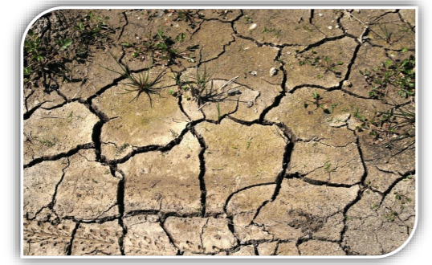
1
2

Slide 6
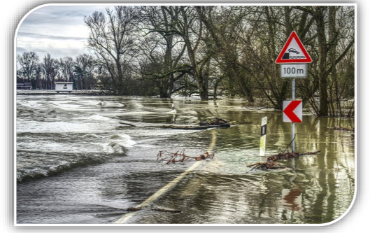
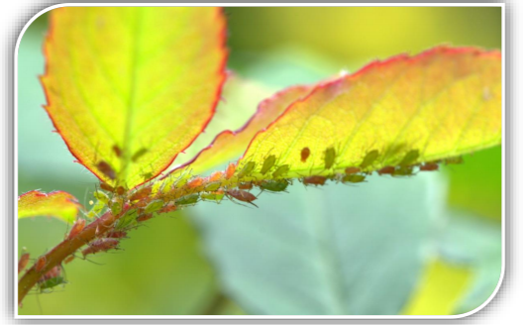
3
4

Slide 7
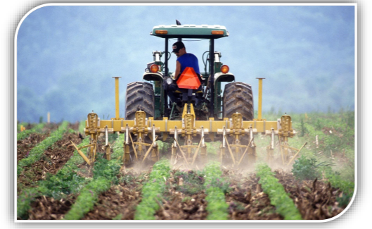
5
6

Slide 8
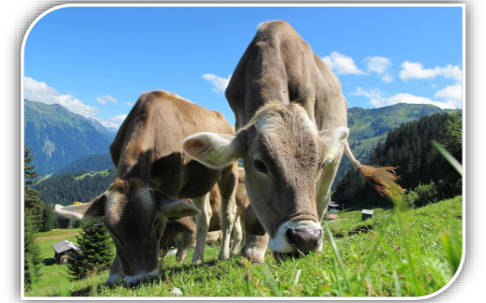
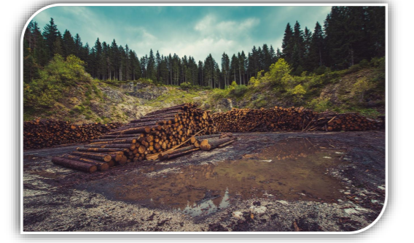
7
8

Slide 9
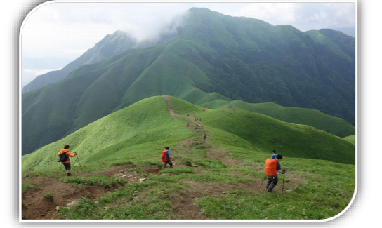
9
10

Slide 10
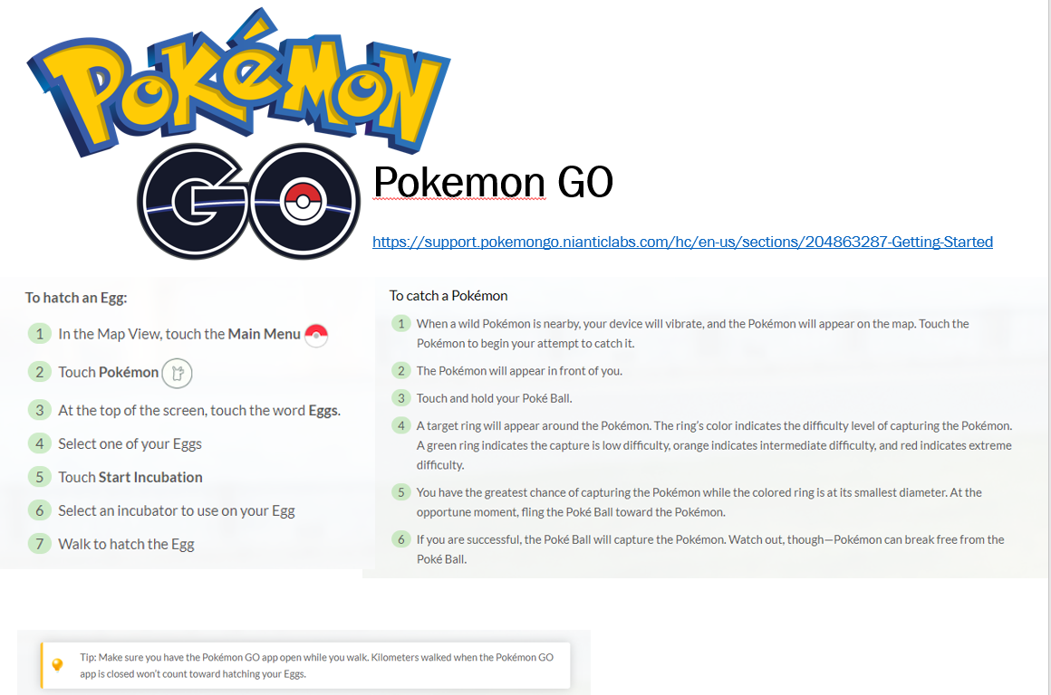
The challenge
Now that you’ve learned lots about threats to plants, your challenge is to design either a table-top or digital game to increase awareness of different threats to temperate plants.
Your game needs to be educational, but above it all it must be fun and interesting; people must want to play it!
Your game must include at least three different types of threats to plants

Slide 11
Top tips
Think about the kind of games that you like to play – can you design something similar?
Make sure to name the threat to plants
Use your imagination: can you use colour and pictures to make your game exciting?
Think about the rules of the game – how do players win?

Slide 12
Useful links
Make your own board game
https://www.wikihow.com/Make-Your-Own-Board-Game
Kew – endangered plants
https://www.kew.org/read-and-watch/plant-undateables-loneliest-plants-in-world

Slide 13
All done?
Well done for completing the challenge!
We hope you enjoyed learning about threats to plants.
Contact your teacher to let them know you are ready to submit your work to them.

