Slide 1

KS2 Battlefield Botany
Instructions for pupils
© Board of Trustees of the Royal Botanic Gardens, Kew

Slide 2
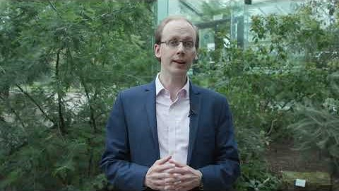
Battlefield botany
During WW1, Kew’s Assistant Director, Arthur Hill, worked with the War Commission to recommend what should be planted on war graves on the Somme battlefields, in France. Plants were used to help transform these battlefield cemeteries into tranquil places for reflection and remembrance.
Watch this video to find out your challenge, then head to the next slide to take part in an activity.

Slide 3
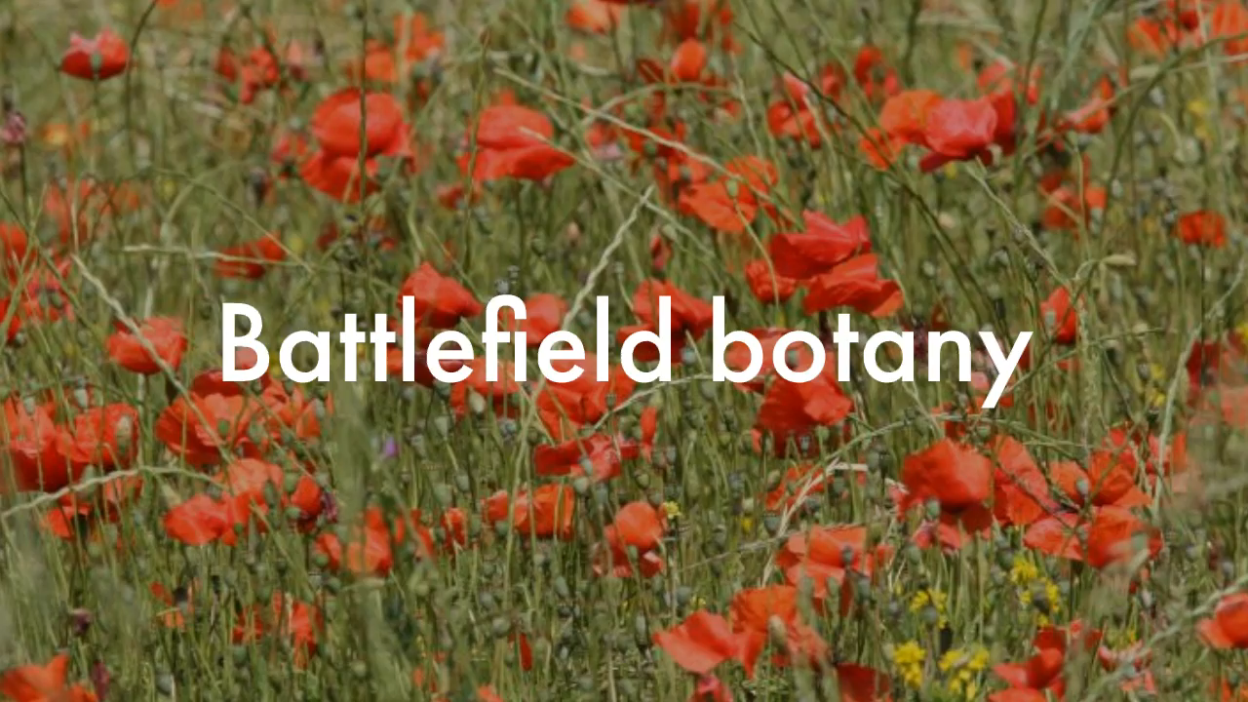
Activity 1
Watch and learn
Did you know that in 1918 the Royal Horticultural Society sent seeds to be used for gardening competitions to British prisoners of war in Germany?
Watch the video to learn more and test your knowledge.

Slide 4
Activity 2
Plant projects
You will need a piece of paper and a pen or pencil to take part in this activity
Look at the following images of projects which use plants to restore or commemorate and see if you can match them with statements about the projects
Number the paper down one side 1 – 5 for the images, then write the letter for the statement you think is a match next to it
Notes:
Card sort or whiteboard activity

Slide 5
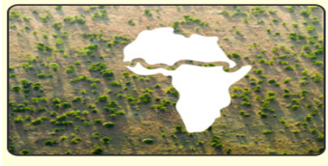
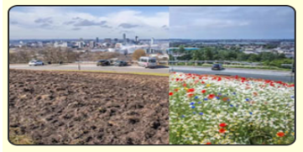
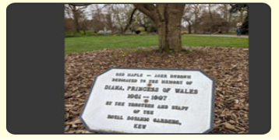
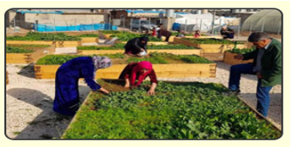
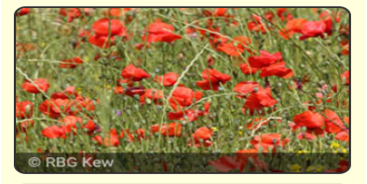
1
2
3
4
5
Notes:
Card sort or whiteboard activity

Slide 6
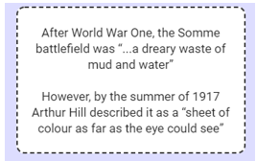
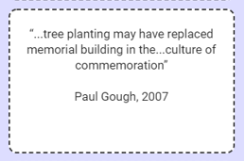
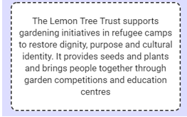
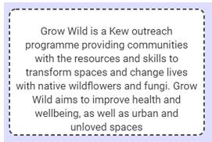
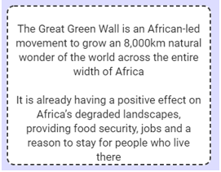
A
B
C
D
E
Notes:
Card sort or whiteboard activity

Slide 7
The challenge
Now that you have learned lots about plants and their power to transform, you’re ready to take on the challenge!
Design a proposal for a neglected or devastated area to be transformed by plants.
This could be an area which is personal to you, an area important to your community, or an area in another part of the country or world.

Slide 8
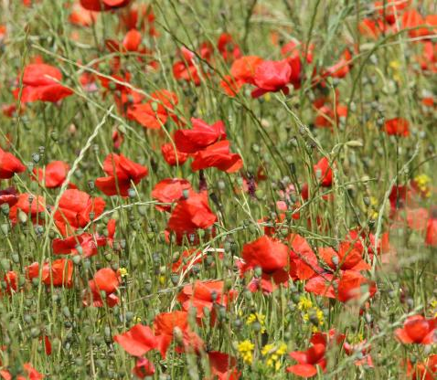
Top tips
Research Sir Arthur Hill and the creating and planting of war cemeteries in the First World War
Research how plants have been and/or are being used to create, restore or preserve landscapes
Decide which plants you will use and why
Consider how people will interact with or be involved in the landscape or area
Consider what the benefits of transforming this area will be. This could be for wildlife, communities, individuals, the government etc.

Slide 9
Useful links
Kew and Arthur Hill
https://www.kew.org/blogs/kew-science/plants-and-conflict-landscapes-%E2%80%93-the-somme-and-beyond
Lemon Tree Trust – gardening in refugee camps
https://lemontreetrust.org/
Why is Africa building a Great Green Wall?
https://www.youtube.com/watch?v=4xls7K_xFBQ

Slide 10
All done?
Well done for completing the challenge!
We hope you enjoyed learning about how plants are used to transform and commemorate.
Contact your teacher to let them know you are ready to submit your work to them.

