Slide 1
KS1 Heroes and villains
Instructions for pupils (and parents)
© Board of Trustees of the Royal Botanic Gardens, Kew

Slide 2
Heroes and villains
You may have eaten a mushroom before, but did you know mushrooms are fungi?
Which of these can help us and which are potentially harmful? Who are the fun-guys and who are the bad guys??
Watch this video to find out your fungi challenge – but before you get going, you’ll need to improve your fungi knowledge.
After the video, head to the next slide to take part in an activity.

Slide 3
Activity 1 Watch and learn
Did you know that acid from some fungi is used to make Lego®?
Watch the video to learn more about fungi and test your knowledge.

Slide 4
Activity 2: Harmful or useful?
You will need a piece of paper and a pen or pencil to take part in this activity
Number the paper down one side 1 – 10
Look at each of the following images and read the descriptions of each fungus to decide whether it is:
HARMFUL
OR
USEFUL
Then you’ll need to write your answer next to the number on your paper

Slide 5
Top tip: read the description to find out what each fungus does Harmful OR Useful What do you think?
1
2

Slide 6
How about these? Harmful OR Useful
3
4

Slide 7
Honey fungus sounds pretty tasty – what do you think? Harmful OR Useful
5
6

Slide 8
What do you think about these? Harmful OR Useful
7
8

Slide 9
Answers: How many did you get right?
1
2
3
4
useful
useful
harmful
useful
5
6
7
8
harmful
useful
harmful
harmful

Slide 10
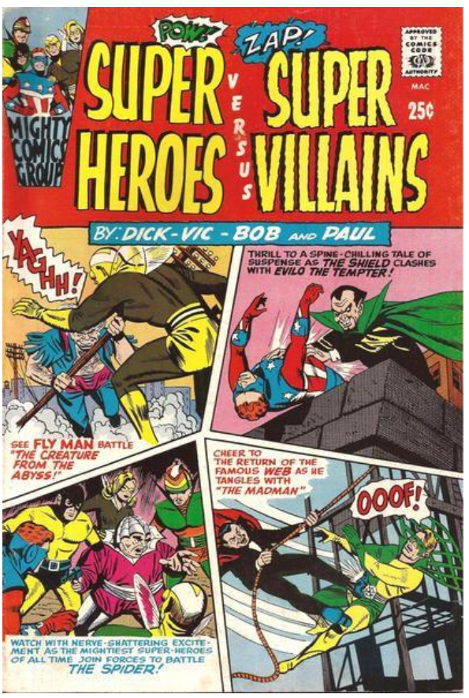
The challenge
Now that you have learned lots about fungi, you’re ready to take on the challenge!
Design a comic book cover or poster with fungi as the heroes or the villains
Your poster can be hand drawn or made using your computer
By “good” we mean fungi that are helpful to plants and animals.
By “bad” we mean fungi that can harm plants and animals.

Slide 11
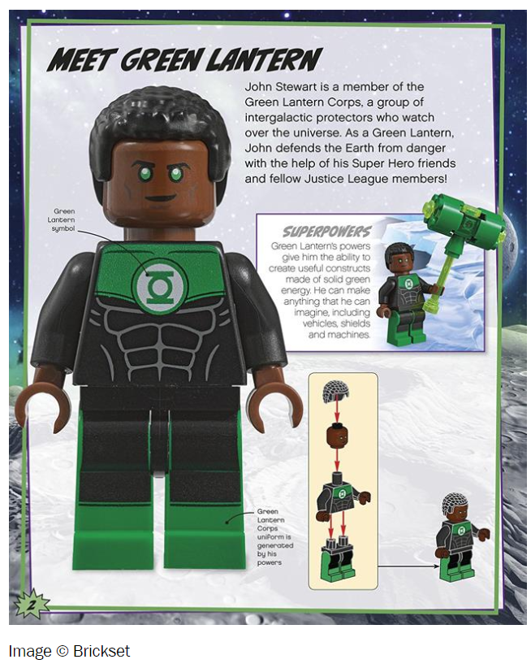
Top tips
Use the internet to research the good and bad effects fungi have on us and the environment
Make sure to name the fungus and what it can do
Make it clear whether your chosen fungus is a hero or a villain – could you use different colours to show this?
Use your imagination: you could think of a fun catchphrase for your hero and villain fungi to include in your design

Slide 12
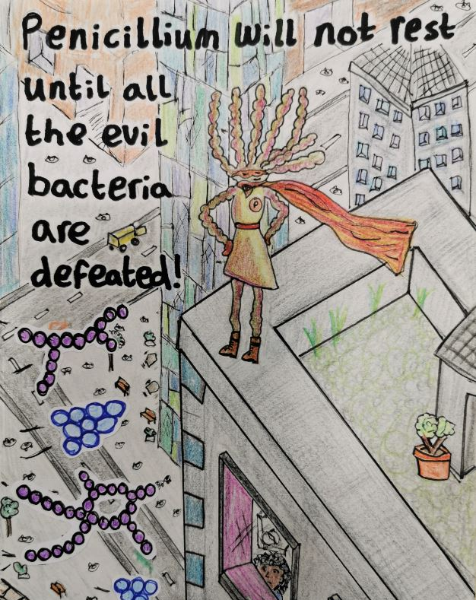
Here’s an example hero…

Slide 13
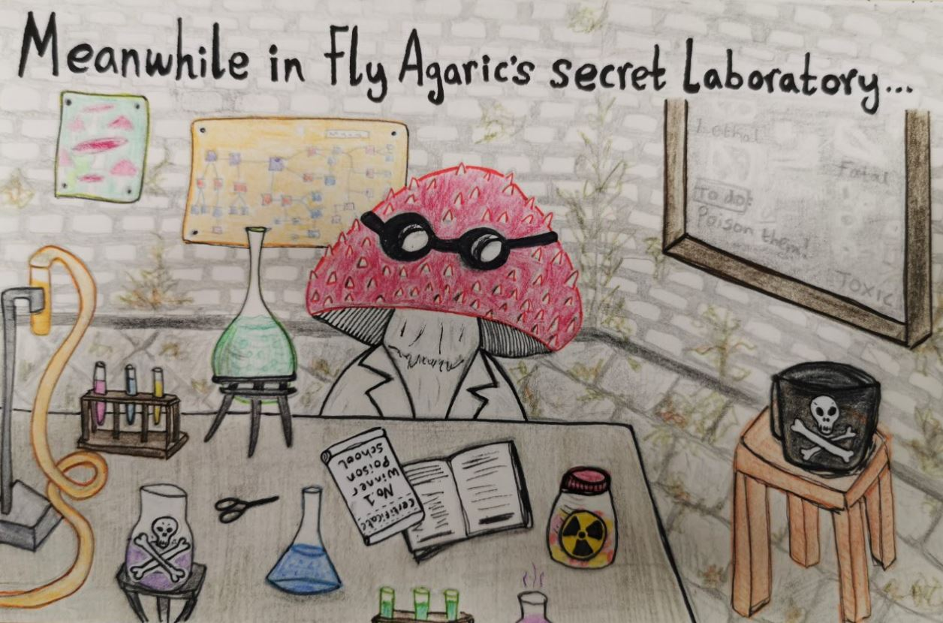
…and an example villain!

Slide 14
Useful links
Blog: 11 Fungi Facts
https://www.kew.org/blogs/in-the-gardens/11-fun-gi-facts
News story: Honey fungus largest living organism
http://www.bbc.co.uk/earth/story/20141114-the-biggest-organism-in-the-world
Video: Attack of the killer fungi
https://www.youtube.com/watch?v=XuKjBIBBAL8

Slide 15
All done?
Well done for completing the challenge!
We hope you enjoyed learning about the fantastic world of fungi.
Contact your teacher to let them know you are ready to submit your work to them.

